Slide 1

ITSAMI - Image Tagging Software Applicable to Many Images
Group 10
Taufeeq Ali, Connor Ford, Fernando Hernandez, Bowen Liu, Tanner Raley, Asher Schubert, San Yun, Joel Zuniga
Notes:
connor

Slide 2

Project Overview
ITSAMI (Image Tagging Software Applicable to Many Images)
Purpose
How does it work?
Notes:
connor
ITSAMI (Image Tagging Software Applicable to Many Images) is a tool designed to use AI to tag and sort images provided by the user from their local directory.
The tool would take an image or image directory input, feed images to the AI model, the model would associate a given tag(s) with the image and then save the images to a local repository for the user to view later

Slide 3
Project Requirements
Functional Requirements
The software shall allow users to load images and their tags from directories into the application.
The software shall be able to display images and their tags.
The software shall be able to process images and create tags with the AI model.
The software shall be able to save an image’s tags as metadata for later use.
The software shall have a search function to find images by their tags.
The model should be able to be used through a Command Line Interface (CLI) in addition to within the application.
Non-Functional Requirements
The application shall be able to access and save multiple images contained in directories to the user’s system along with their associated tags.
The application shall return an image tagging request within several seconds to some minutes at most depending on image complexity and size
The application shall be able to support multiple tags per image.
The application should be portable.
Notes:
Connor / tanner

Slide 4
Key Functionalities
The projects functionalities include
Taking image input from the user
Passing images to the AI model to be processed
Model views and parses images
Assigns tag to image based on key identifiers
Stores images in a local repository associated with the appropriate tag

Slide 5
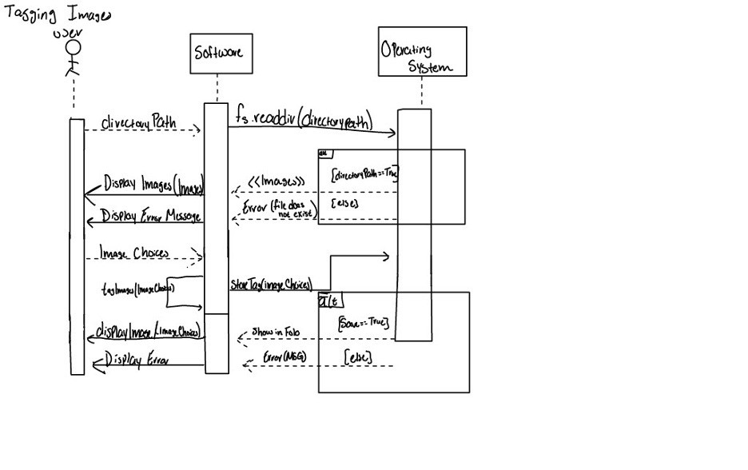
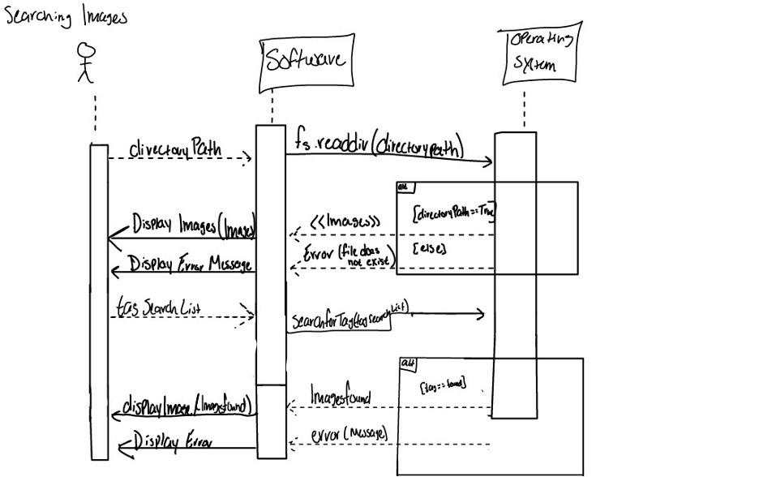
Diagrams 1 (sequence diagram)
Tagging Images
Searching Images
Notes:
Fernando

Slide 6
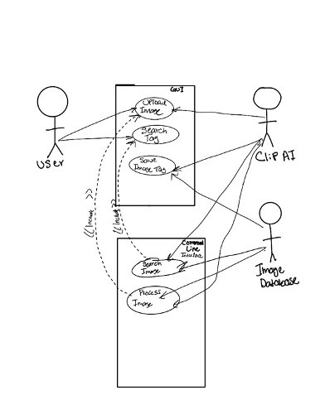
Diagrams 2 (Use-Case)
Notes:
Fernando

Slide 7
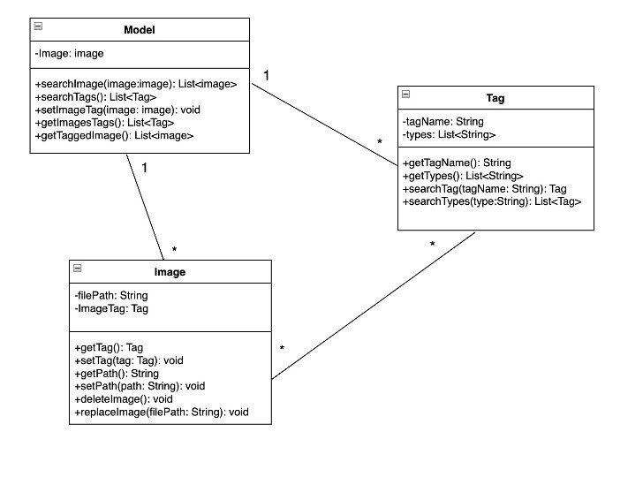
Diagrams 2 (Class)
Notes:
Fernando

Slide 8
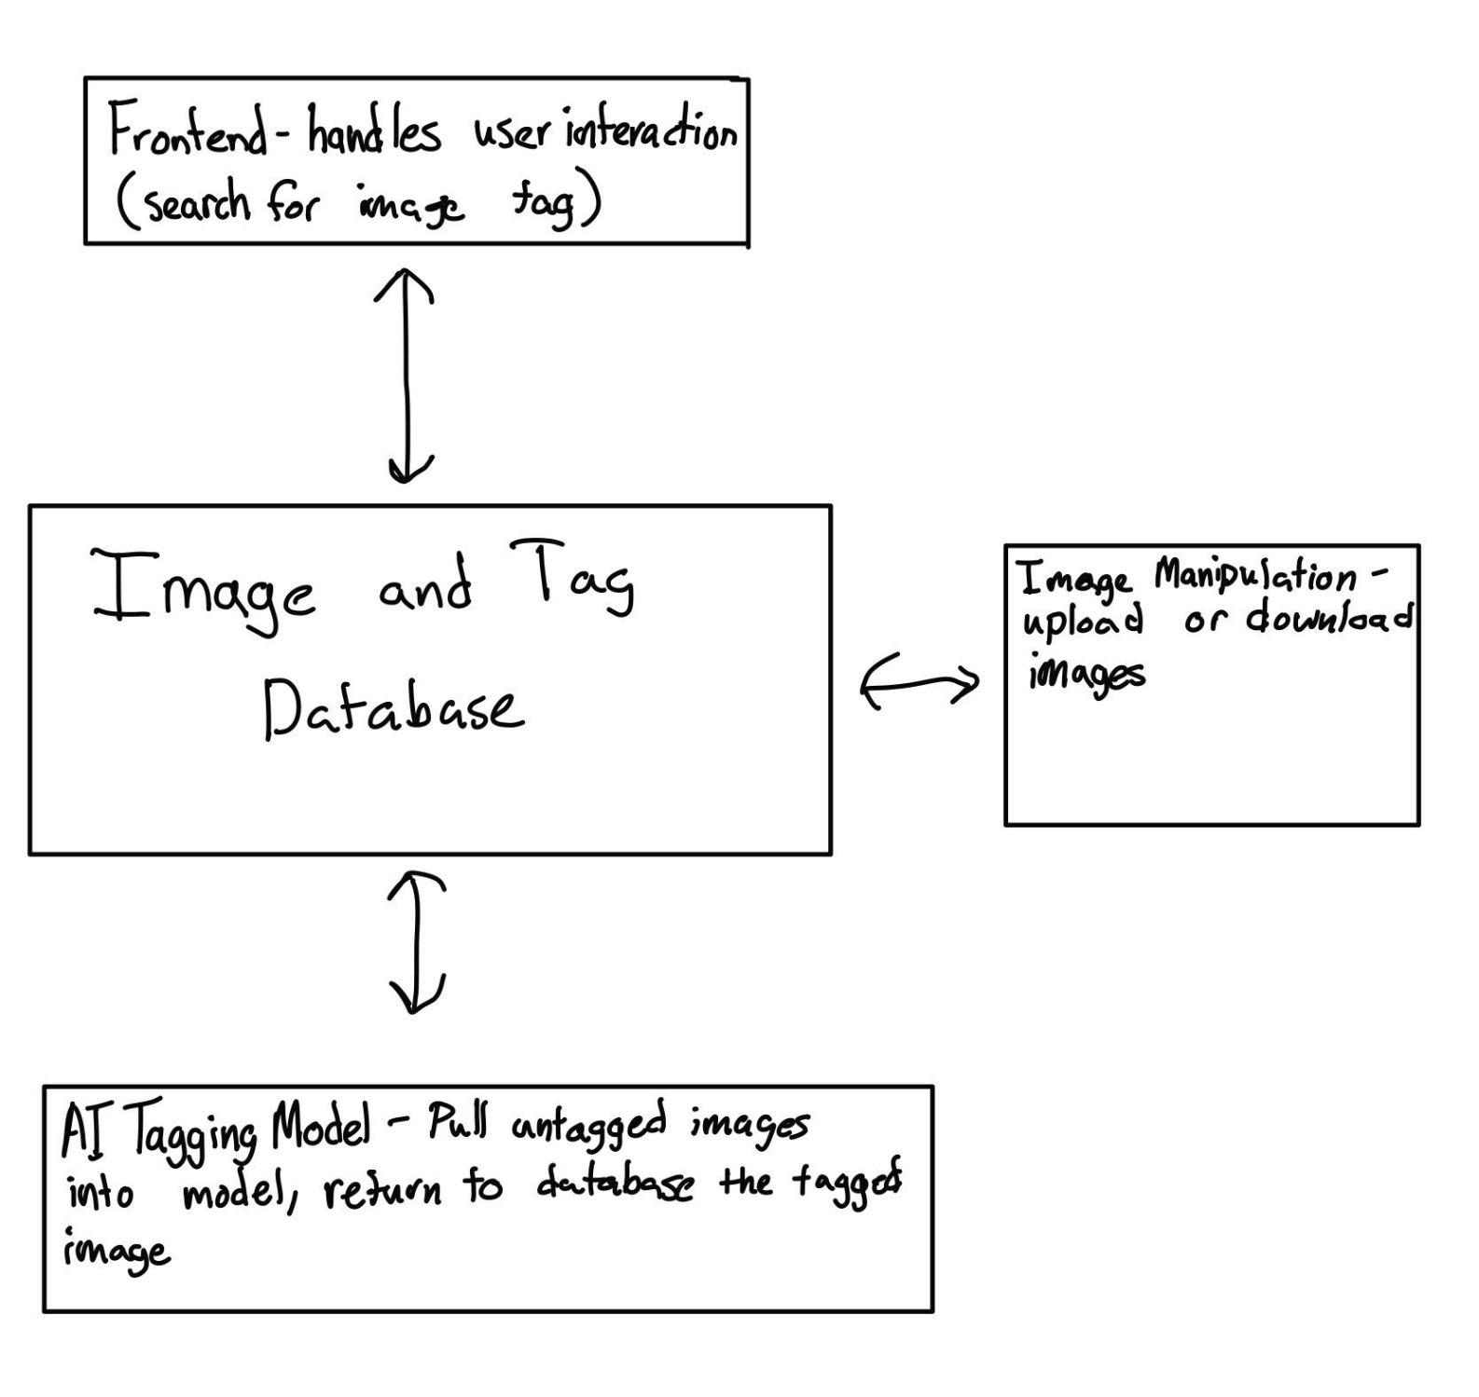
Architectural Design
Chosen Pattern: Repository Pattern
Reason for Selection:
Application generates large volumes of persistent data (e.g., image tags)
Repository provides a structured approach to data access
Simplifies operations like adding, modifying, and deleting tags

Slide 9
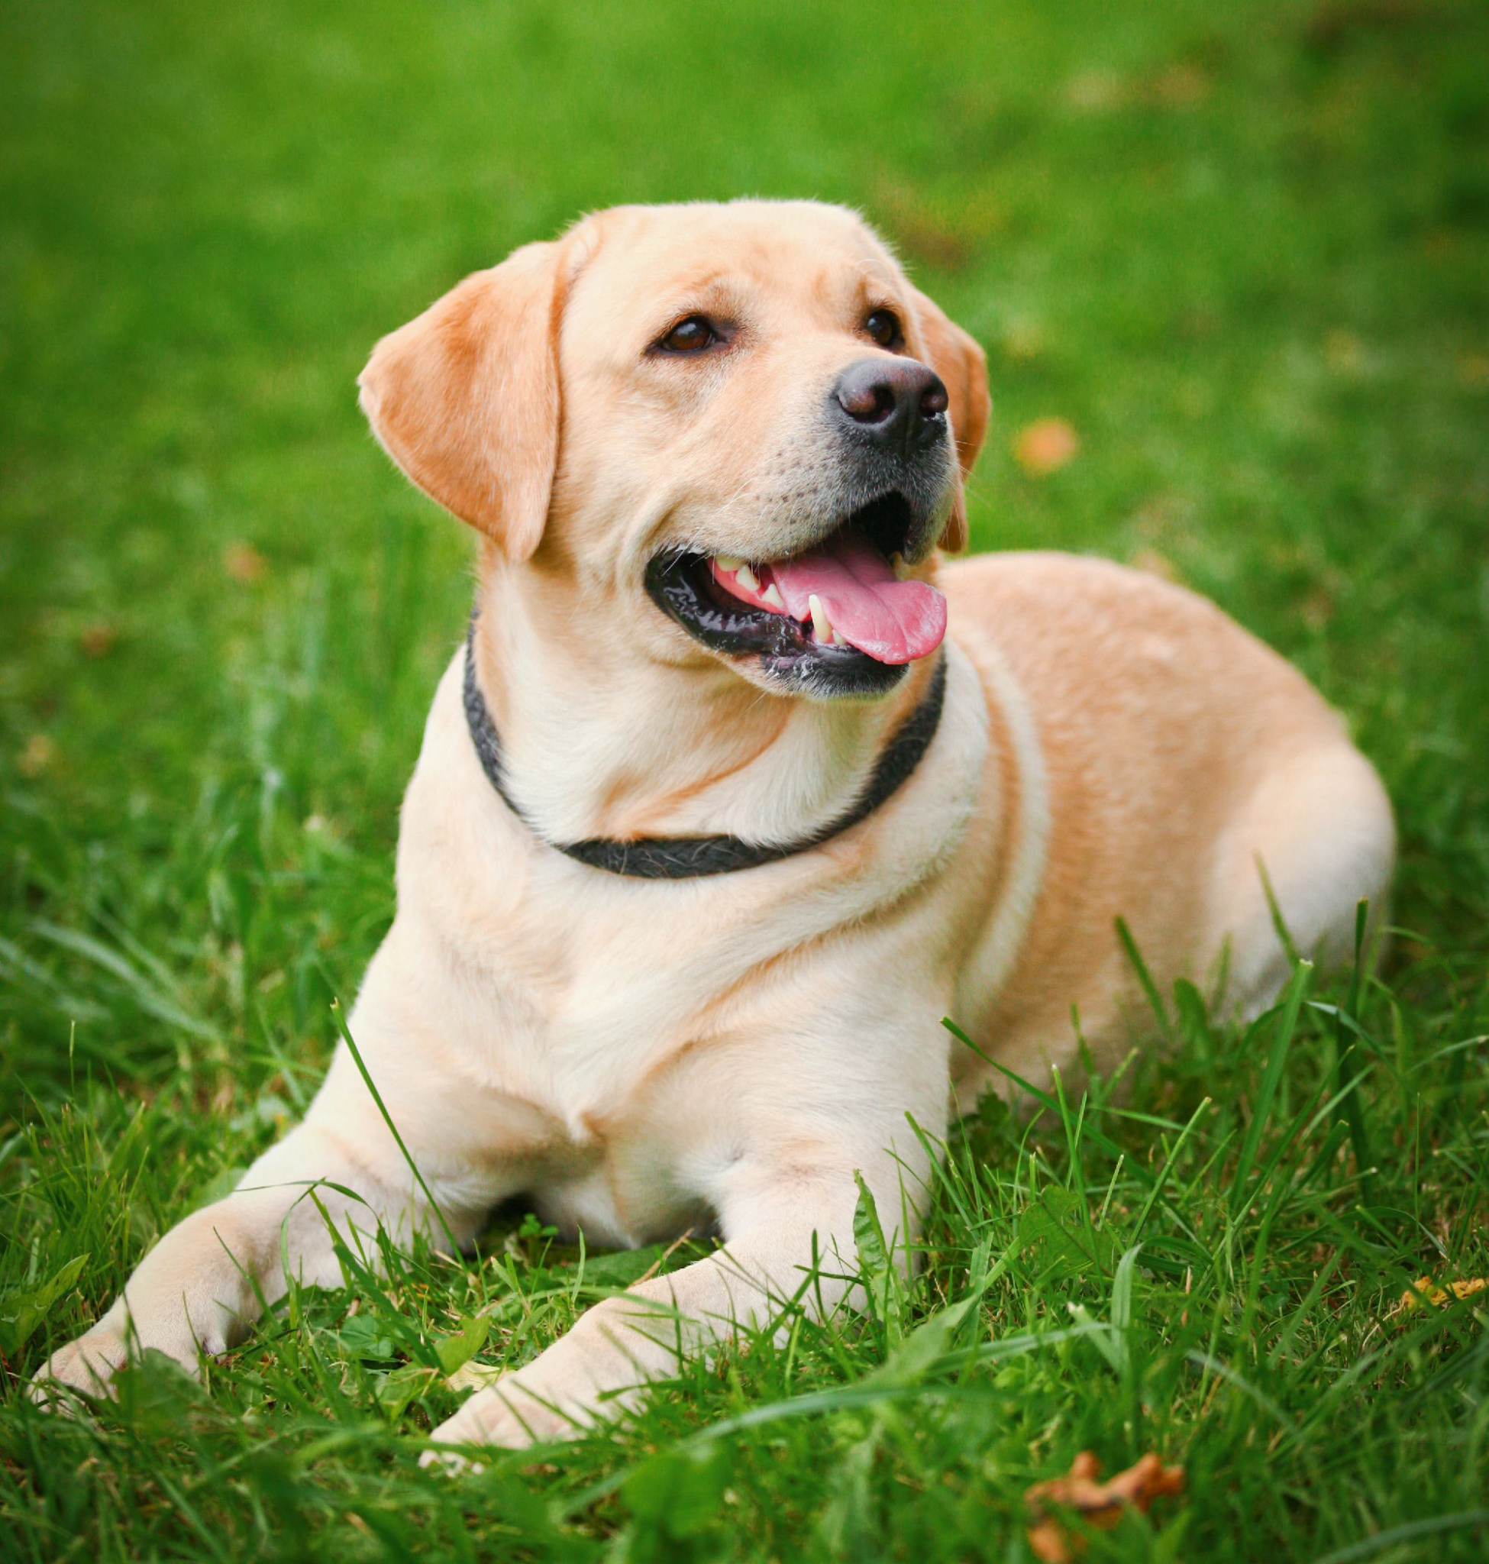

Testing
Black Box Testing
ITSAMI
Software
<Dog>
<Grass>
ITSAMI
Software
<Mustache> <Red>
Notes:
Fernando

Slide 10
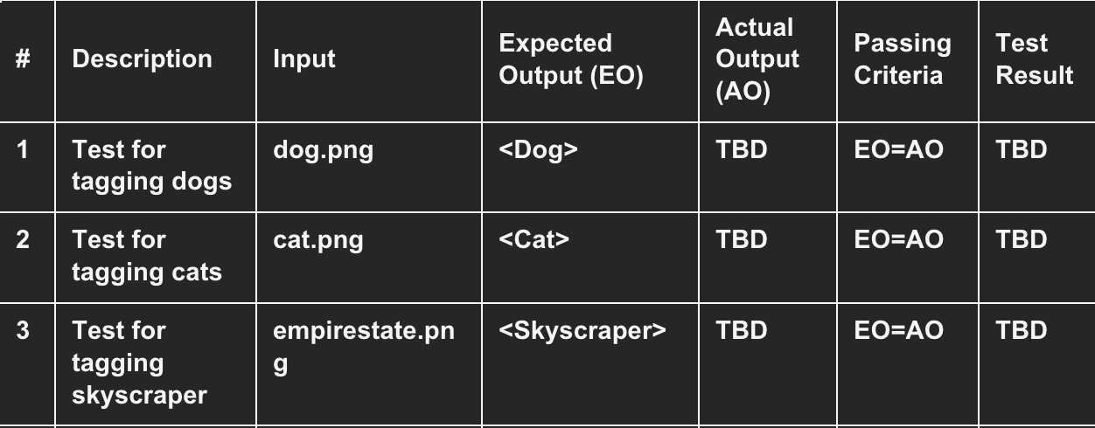
Testing
White Box Testing
Notes:
fernando

Slide 11
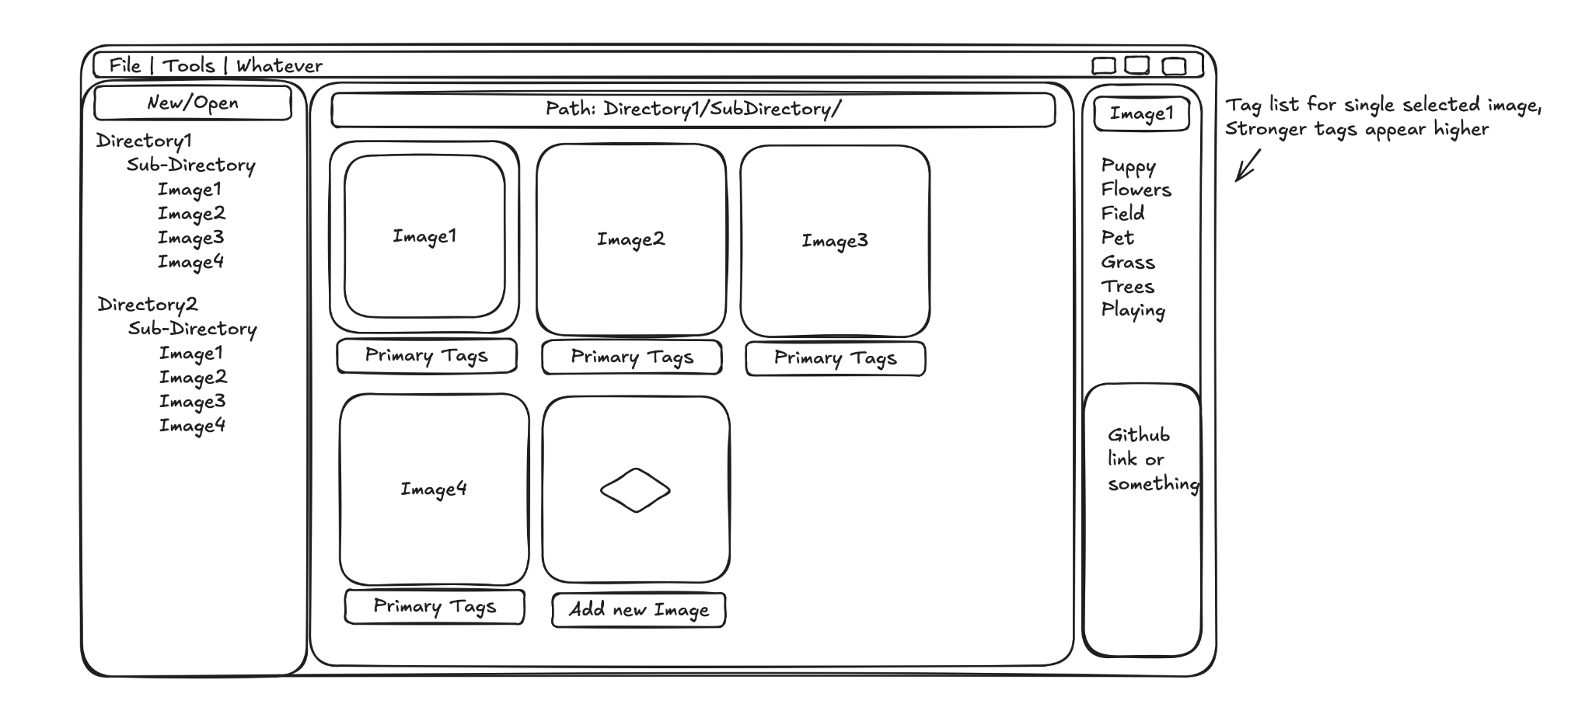
Prototype UI and Flow
Notes:
asher

Slide 12
Project Scheduling
Task | Effort (person-days) | Duration (days) | Dependencies | Activity
T1 | 10 | 4 | N/A | planning code structure
T2 | 20 | 10 | N/A | Culminate test image database
T3 | 45 | 15 | T1 | develop tagging software
T4 | 15 | 7 | T2 | Create possible image tag database
T5 | 15 | 5 | T3 | test individual tag creation
T6 | 5 | 3 | T3 | test new tag creation
T7 | 20 | 5 | T3 | test new image uploading and tagging
Notes:
ranner

Slide 13
Project Scheduling Cont.
Days: | 1-3 | 4-6 | 7-9 | 10-12 | 13-15 | 16-18 | 19-21
Taufeeq
Connor
Fernando
Bowen
Tanner
Asher
San
Joel
T1 | T2 | T3 | T4 | T5 | T6 | T7
Notes:
tanner

Slide 14
Feature | rclip | Eagle | Adobe Bridge | Hydrus | Our System Goal
GUI | ❌ | ✅ | ✅ | ✅ | ✅(Modern)
Auto-Tagging | ❌ | ❌ | ❌ | ❌ | ✅(AI-Powered)
Manual Tagging | ❌ | ✅ | ✅ | ✅ | ✅
Offline Support | ✅ | ✅ | ✅ | ✅ | ✅
Advanced Search | ❌ | ✅(Basic) | ✅(Metadata) | ✅ | ✅(AI + Filters)
Performance | ✅ | ✅(Medium) | ❌(Heavy) | ❌(Slow) | ✅
Cross-Platform | ✅ | ✅ | ❌(Win/Mac) | ✅ | ✅
Metadata Support | ❌ | ✅ | ✅ | ✅ | ✅
Batch Processing | ❌ | ✅ | ✅ | ✅ | ✅
Extensibility | ❌ | ✅(Plugins) | ✅(Scripts) | ✅(Plugins) | ✅(Plugins)
Notes:
fernando

Slide 15
Similar Design Comparisons
Adobe Bridge
Purpose: File browser with metadata management for creatives.
Strengths:
Metadata Filtering: EXIF, IPTC, custom keywords.
Integration: Works with Photoshop/Lightroom.
Weaknesses:
No AI: Tagging is manual.
Bloated: Heavy resource usage.
Hydrus Network
Purpose: Advanced local media tagging.
Strengths:
Powerful Tagging: Boolean search, wildcards, namespaces.
Customization: Plugins for external AI.
Weaknesses:
Steep Learning Curve: Overwhelming for casual users.
No Native AI: Requires manual setup.
Notes:
Bowen

Slide 16
Similar Design Comparisons
rclip(Existing CLI Tool)
Purpose: Searches local images using OpenAI CLIP embeddings via text queries.
Strengths:
Fast, scriptable, and lightweight
Works offline after setup
Weaknesses:
No GUI: Requires command-line knowledge.
Outdated Model: Uses older CLIP(ViT-B/32), missing newer improvements.
No Auto-Tagging: Only search, no persistent tagging system.
Eagle App
Purpose: Asset manager for designers
Strengths:
Visual Browsing: Grid/column views, quick previews.
Manual Tagging: Support folders, labels, and annotations.
Extensions: Some AI plugins(but not deeply integrated)
Weaknesses:
No Built-in AI Tagging: Relies on manual input.
Proprietary: Not open-source.
Notes:
Bowen

Slide 17
Task Delegations
Deliverable 1
Taufeeq Ali: Class Diagram
Connor Ford: Outlining Software Process Model, Functional Requirements, GitHub repository
Fernando Hernandez: Use-Case Diagram
Bowen Liu: Updated Version of Proposal
Tanner Raley: Non-Functional Requirements, Architectural Design
Asher Schubert: Activity/Sequence Diagram
San Yun: Class Diagram
Joel Zuniga: Functional Requirements, Non-Functional Requirements
Deliverable 2
Taufeeq Ali: Slides and Presentation
Connor Ford: Project management, GitHub repository
Fernando Hernandez: Software Testing
Bowen Liu: Similar Design Comparisons
Tanner Raley: Project Scheduling, Cost, Effort and Pricing Estimation, Project Duration and Staffing, Estimated Costs of Hardware, Software, and Personnel
Asher Schubert: Refinement of Requirements, UI Mockup
San Yun: Slides and Presentation
Joel Zuniga: UI

Slide 18
Conclusion
Key Takeaways
Applied core software engineering principles to plan the ITSAMI project
Developed key artifacts: requirements, process models, architecture, scheduling, cost estimates, and testing strategies
Followed a structured, phase-by-phase approach through the software development lifecycle
Challenges Encountered
Iterative refinement of functional and non-functional requirements
Cost and effort estimation required assumptions due to lack of implementation
Ensuring consistency across design artifacts (diagrams, architecture) was communication-intensive
Prototype design introduced conflicts with earlier artifacts that required reconciliation
Lessons Learned
Early, thorough planning helps mitigate long-term risks
Effective team collaboration requires clear role assignments and detailed documentation
Coordinating a large team was difficult, prompting use of flexible communication methods
Final Reflection
Deliverable 2 shows a strong understanding of software engineering processes
Provides a solid foundation for future ITSAMI development
Notes:
Connor

Slide 19
Thank You
References
Mikhalevich, Yurij. “Using Text Queries to Look up Unlabeled Images: A Command-Line Search Tool Based on Clip.” ThinkMind(TM) Digital Library, 26 June 2023, www.thinkmind.org/index.php?view=article&articleid=content_2023_1_20_60011.

